Slide 1










BCS202L- Data Structures and Algorithms
Dr. Priyanka N
Assistant Professor Senior Grade 1
School of Computer Science & Engineering VIT, Vellore.

Slide 2




BCS202L- Data Structures and Algorithms
Module-1: Algorithm Analysis
Module-2: Linear Data Structures
Module-3: Searching and Sorting
Module-4:Trees
Module-5: Graphs
Module-6: Hashing
Module-7: Heaps and AVL Trees

Slide 3
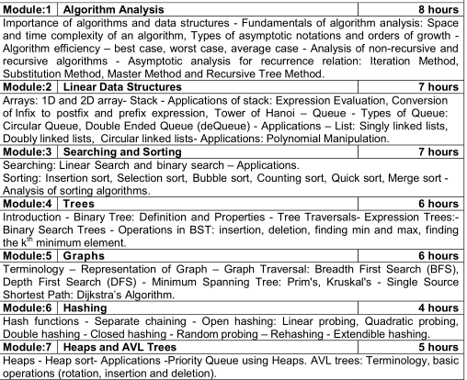

Slide 4
BCS202L- Data Structures and Algorithms
Text Books:
1. Mark A. Weiss, Data Structures & Algorithm Analysis in C++, 4 th
Edition, 2013,Pearson Education.
Reference Books:
Alfred V. Aho, Jeffrey D. Ullman and John E. Hopcroft, Data
Structures and Algorithms,1983, Pearson Education.
Horowitz, Sahni and S. Anderson-Freed, Fundamentals of Data Structures in C, 2008, 2nd Edition, Universities Press.
Thomas H. Cormen, C.E. Leiserson, R L. Rivest and C. Stein,
Introduction to Algorithms, 2009, 3rd Edition, MIT Press.

Slide 5


Module 5: Graphs( 6 Hours)
Terminology and Representation
Graph Traversal
DFS
BFS
Minimum Spanning Tree
Prim’s Algorithm
Kruskal’s Algorithm
Single Source Shortest Path
Dijkstra’s Algorithm

Slide 6

Graph Traversal
Graph traversal is a technique used for a searching vertex in a graph.
Used to decide the order of vertices is visited in the search process.
A graph traversal finds the edges to be used in the search process without creating loops. That means using graph traversal we visit all the vertices of the graph without getting into looping path.
Depth First Search
Breadth First Search

Slide 7
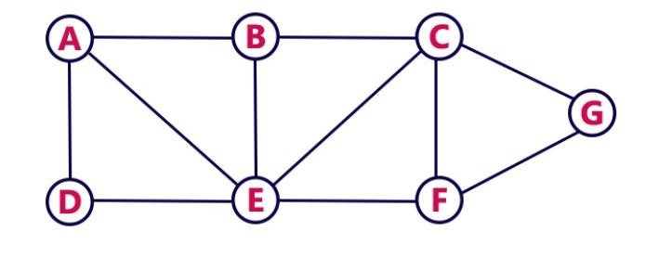
Depth First Search
DFS traversal of a graph produces a spanning tree as a result
Spanning Tree is a graph without loops
Consider the Following Example

Slide 8
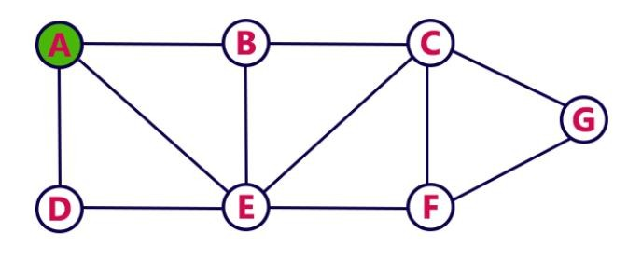
Depth First Search- STEP1
Choose the Starting Vertex as A
VISIT A
Push A into the Stack
A
RESULT: A
STACK

Slide 9
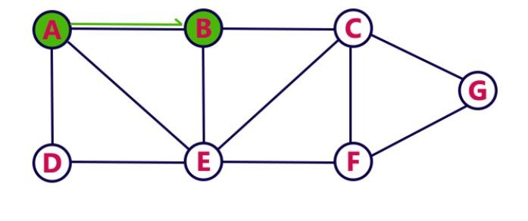
Depth First Search- STEP 2
Visit any adjacent vertex of A which is not visited ( taken B)
VISIT B
Push newly visited B into the Stack
B
A
RESULT: A B
STACK

Slide 10
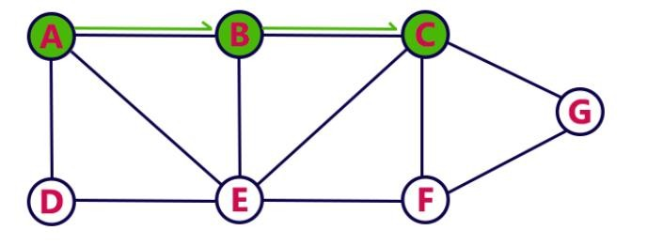
Depth First Search- STEP 3
Visit any adjacent vertex of B which is not visited ( taken C)
VISIT C
Push newly visited C into the Stack
C
B
A
RESULT: A B C
STACK

Slide 11
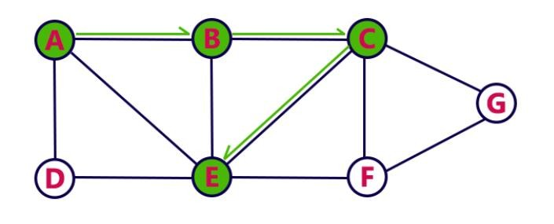
Depth First Search- STEP 4
Visit any adjacent vertex of C which is not visited ( taken E)
VISIT E
Push newly visited E into the Stack
E
C
B
A
RESULT: A B C E
STACK

Slide 12
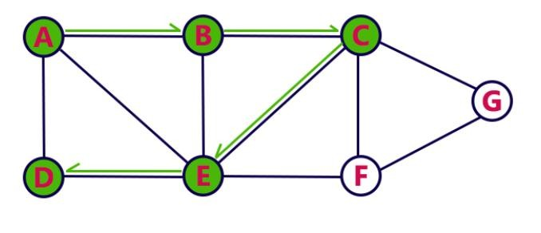
Depth First Search- STEP 5
Visit any adjacent vertex of E which is not visited ( taken D)
VISIT D
Push newly visited D into the Stack
D
E
C
B
A
RESULT: A B C E D
STACK

Slide 13
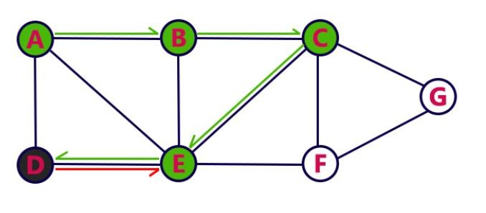
Depth First Search- STEP 6
No new vertex to be visited from D
POP D
E
C
B
A
RESULT: A B C E D
STACK

Slide 14

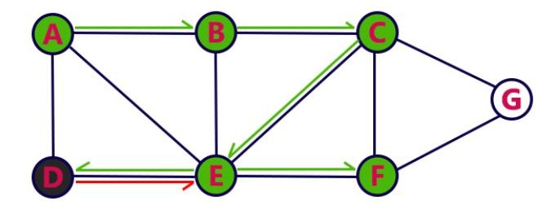
Depth First Search- STEP 7
Visit any adjacent vertex of E which is not visited ( taken F)
VISIT F
Push newly visited F into the Stack
F
E
C
B
A
RESULT: A B C E D F
STACK

Slide 15
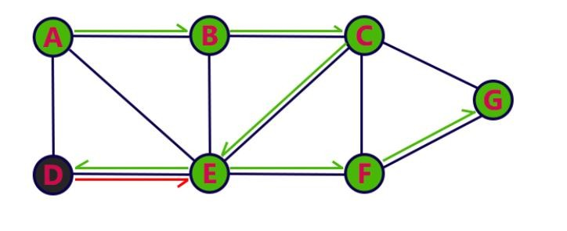
Depth First Search- STEP 8
Visit any adjacent vertex of F which is not visited ( taken G)
VISIT G
Push newly visited G into the Stack
G
F
E
C
B
A
RESULT: A B C E D F G
STACK

Slide 16

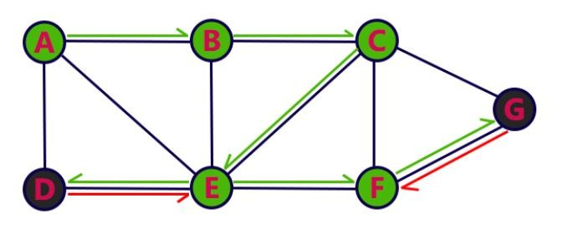
Depth First Search- STEP 9
No new vertex to be visited from G
POP G
F
E
C
B
A
RESULT: A B C E D F G
STACK

Slide 17
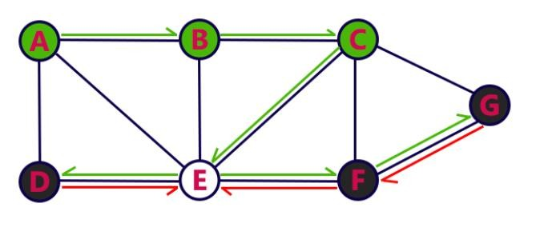
Depth First Search- STEP 10
No new vertex to be visited from F
POP F
E
C
B
A
RESULT: A B C E D F G
STACK

Slide 18

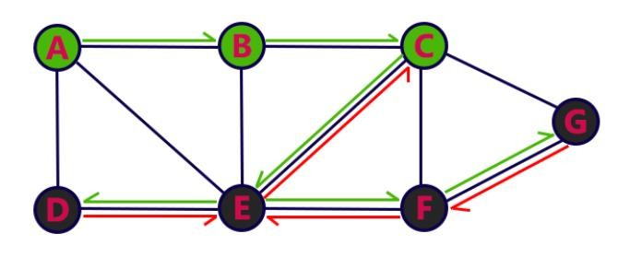
Depth First Search- STEP 11
No new vertex to be visited from E
POP E
C
B
A
RESULT: A B C E D F G
STACK

Slide 19
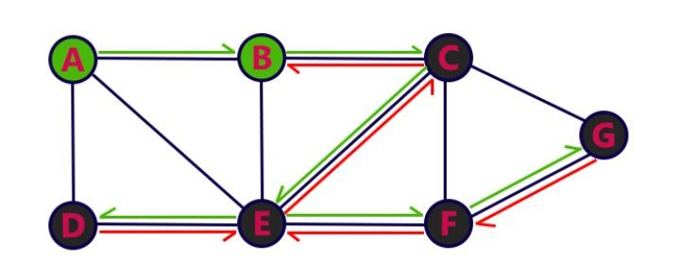
Depth First Search- STEP 12
No new vertex to be visited from C
POP C
B
A
RESULT: A B C E D F G
STACK

Slide 20
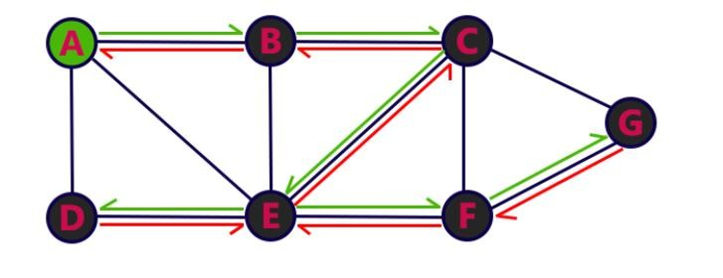
Depth First Search- STEP 13
No new vertex to be visited from B
POP B
A
RESULT: A B C E D F G
STACK

Slide 21
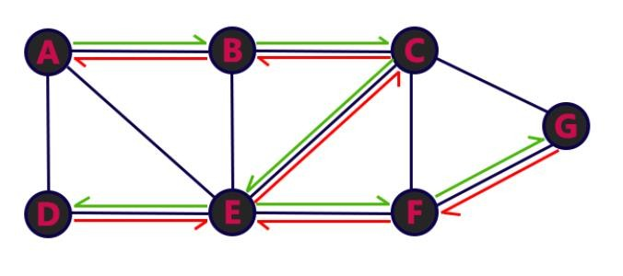
Depth First Search- STEP 14
No new vertex to be visited from A
POP A
RESULT: A B C E D F G
Stack Empty, End the DFS traversal
STACK

Slide 22
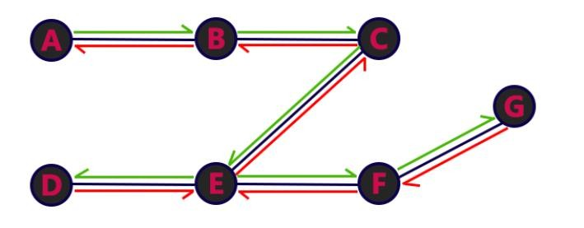
DFS Traversal - Result
A→B→C→E→D→F→G

Slide 23
Algorithm DFS(V) // n- number of vertices
{
int adj;
vis[v]=1; // Array to track the visited node
printf("%d", v);
for(adj=1;adj<=n;adj++) // Iterating adjacent vertices of “v”
{
if(vis[adj]==0) // Adjacent node is not visited
{
if(adj[v][adj]==1)
{
dfs(adj);
}
}
}
}

Slide 24
Breadth First Search
BFS traversal of
a graph produces as result. Spanning
a spanning tree
Tree is a graph without loops.
Consider the Following Example

Slide 25
Breadth First Search- STEP1
Choose the Starting Vertex as A
VISIT A
Insert A into the Queue
QUEUE:
A

Slide 26
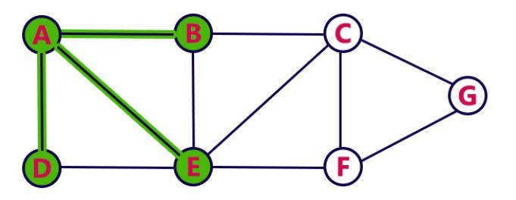
Breadth First Search- STEP2
Visit all adjacent vertices of A which are not visited(Here: D,E,B)
Insert newly visited vertices into the queue and delete A from the Queue
QUEUE:
 | D | E | B
RESULT: A

Slide 27
Breadth First Search- STEP3
Visit all adjacent vertices of D which are not visited(No Vertex)
Delete D from the Queue
QUEUE:
 |  | E | B
RESULT: A D

Slide 28
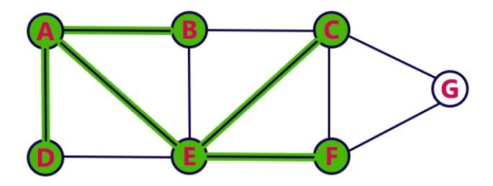
Breadth First Search- STEP4
Visit all adjacent vertices of E which are not visited(Here C, F)
Insert newly visited vertices into the queue and delete E from the Queue
QUEUE:
B
C
F
RESULT: A D E

Slide 29
Breadth First Search- STEP5
Visit all adjacent vertices of B which are not visited(No Vertex)
Delete B from the Queue
QUEUE:
C
F
RESULT: A D E B

Slide 30
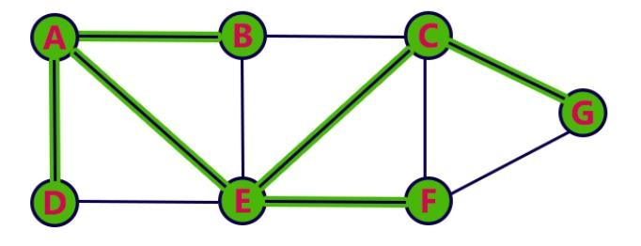
Breadth First Search- STEP6
Visit all adjacent vertices of C which are not visited(Here G)
Insert newly visited vertices into the queue and delete C from the Queue
QUEUE:
F
G
RESULT: A D E B C

Slide 31
Breadth First Search- STEP7
Visit all adjacent vertices of F which are not visited(Here No Vertex)
Delete F from the Queue
QUEUE:
G
RESULT: A D E B C F

Slide 32
Breadth First Search- STEP8
Visit all adjacent vertices of G which are not visited(Here No Vertex)
Delete G from the Queue
QUEUE:
RESULT: A D E B C F G
Queue Empty, End the Process

Slide 33
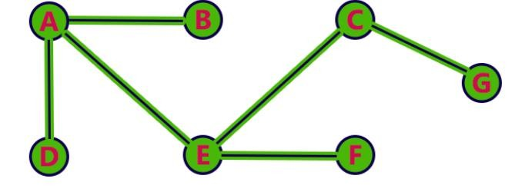
BFS Traversal - Result
A→D→E→B→C→F→G

Slide 34
Breadth First Search(v)
{
U=v; // Maintaining a queue of adjacent vertices for “v”
visited[v]=1; // Array to track the visited node
while U is not empty
{
v<-dequeue from U
for each vertices ‘W’ adjacent from U do
{
if(visited[W]=0) then
{
Add ‘W’ to the Queue; // W is also unexplored vertices
visited[W]=1;
}
} // end of for loop
}
}

Slide 35

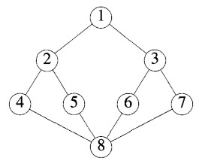
Sample Exercises
Problem 1
Problem 2
d
a
i
c
b
g
h
e
f
j

Slide 36
Key Differences Between BFS and DFS
BFS is a vertex-based algorithm while DFS is an edge-based algorithm.
The queue data structure is used in BFS. On the other hand, DFS uses stack or recursion.
Memory space is efficiently utilized in DFS while space utilization in BFS is not effective.
BFS is the optimal algorithm while DFS is not optimal.
DFS constructs narrow and long trees. As against, BFS constructs wide and short trees.

